Slide 1
UNIT IV BACKTRACKING
Session –26

Slide 2
Syllabus
Introduction - NXN Queen's Problem - Sum of Subsets - Graph Coloring - Hamiltonian's Circuit - Travelling Salesman Problem - Generating Permutation

Slide 3
Introduction to Back tracking
Generalized Algorithm:
Pick a starting point.
while(Problem is not solved)
For each path from the starting point.
check if selected path is safe, if yes select it and make recursive call to rest of the problem
If recursive calls return true, then return true.
else undo the current move and return false.
End For
If none of the move works out, return false, NO SOLUTON.

Slide 4
Graph Coloring

Slide 5
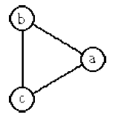
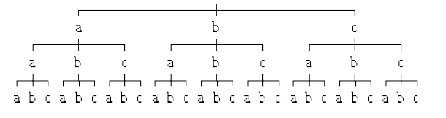

Slide 6
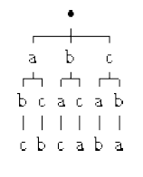

Slide 7
Hamiltonian Circuit
Let G=(V,E) be a connected graph with n vertices.
A HAMILTONIAN CYCLE is a round trip path along n edges of G which every vertex once and returns to its starting position.
If the Hamiltonian cycle begins at some vertex V1 belongs to G and the vertex are visited in the order of V1,V2…….Vn+1,then the edges are in E, 1<=i<=n and the Vi are distinct except V1 and Vn+1 which are equal.

Slide 8
Consider an example graph G1.
The graph G1 has Hamiltonian cycles:
1,3,4,5,6,7,8,2,1
1,2,8,7,6,5,4,3,1.

Slide 9
Algorithm
Algorithm Hamiltonian (k)
Loop
Next value (k)
If (x (k)=0) then return;
If k=n then Print (x)
Else Hamiltonian (k+1);
End if
Repeat

Slide 10
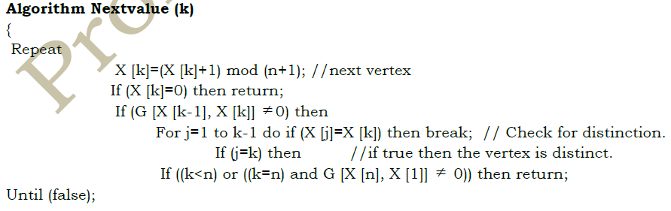

Slide 11
Worksheet No. 26, 27 & 28

